Slide 2
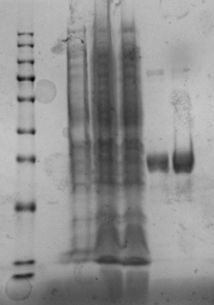
kDa
180
140
100
75
60
45
35
25
15
0
1
2
3
4
5
10

Slide 3
kDa
180
140
100
75
60
45
35
25
15
0 1 2 3 4 5
10

Slide 4
kDa
180
140
100
75
60
45
35
25
15
10
Marker 0 1 2 3 4 5

Slide 5
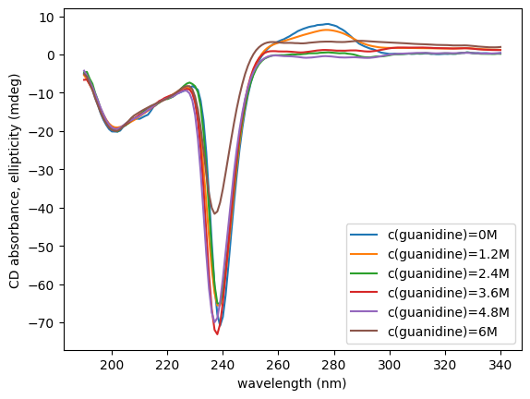
Decrease with
guanidine concentration
Increase with
guanidine concentration

Slide 6
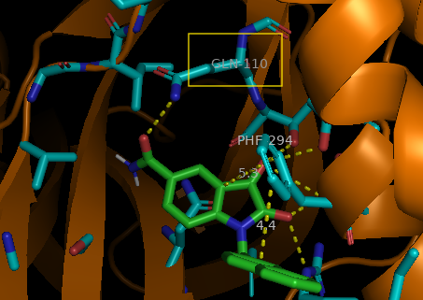
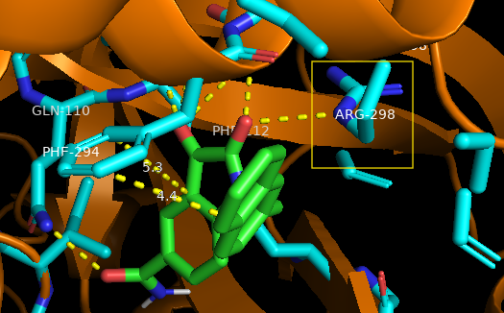
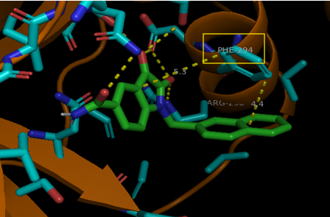

Slide 7
